Slide 1

Unit 01.01.01 CS 5220: COMPUTER COMMUNICATIONS
Evolution of Communication Networks
XIAOBO ZHOU, Ph.D.
Professor, Department of Computer Science

Slide 2
What is a Communication Network?
The equipment (hardware & software) and facilities that provide the basic communication service
Facilities
Copper wires, optical fiber …
Communication
Network
Equipment
Routers, servers, switches, …

Slide 3
Network Architecture Evolution
?
Information transfer
per second
Telegraph
networks
Telephone
networks
Internet, Optical
& Wireless
networks
Next Generation Internet

Slide 4
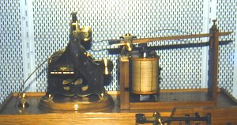
Telegraph Networks
Telegraph: a message is transmitted across a network using signals
Drums, beacons, mirrors, smoke, flags, semaphores…
Electricity, light

Slide 5
Digital Communications
Morse code converts text message in sequence of dots & dashes
Use transmission system designed to convey dots and dashes
 | Morse Code |  | Morse Code |  | Morse Code |  | Morse Code
A | · — | J | · — — — | S | · · · | 2 | · · — — —
B | — · · · | K | — · — | T | — | 3 | · · · — —
C | — · — · | L | · — · · | U | · · — | 4 | · · · · —
D | — · · | M | — — | V | · · · — | 5 | · · · · ·
E | · | N | — · | W | · — — | 6 | — · · · ·
F | · · — · | O | — — — | X | — · · — | 7 | — — · · ·
G | — — · | P | · — — · | Y | — · — — | 8 | — — — · ·
H | · · · · | Q | — — · — | Z | — — · · | 9 | — — — — ·
I | · · | R | · — · | 1 | · — — — — | 0 | — — — — —

Slide 6
Electric Telegraph Networks
Electric telegraph networks exploded
Message switching & Store-and-Forward operation
Key elements: Framing, Multiplexing, Addressing, Routing, Forwarding
Message
Message
Message
Source
Message
Switches
Destination

Slide 7
Elements of Telegraph Networks
Digital transmission
Text messages converted into symbols
Transmission system designed to convey symbols
Multiplexing
Framing needed to recover text characters
Message Switching
Messages contain source & destination addresses
Store-and-Forward: messages forwarded hop-by-hop across network
Routing according to destination address

Slide 8
Bell’s Telephone
Alexander G. Bell (1876) working on harmonic telegraph to multiplexing discovered voice signals can be transmitted directly
Microphone converts voice pressure variation into analogous electrical signal
Loudspeaker converts electrical signal back into sound
Basic telephone service involves two-way, real-time transmission of voice signals across a network
Signaling required to establish a call
Signaling + voice signal transfer

Slide 9
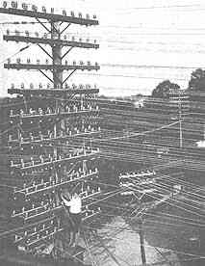
The N² Problem
Initially, p2p direct communications - for N users to be fully connected directly
Requires too much space for cables
Inefficient & costly since connections not always on
1
N
2
N = 1000
N(N – 1)/2 = 499500
. . .
4
3

Slide 10
Circuit Switching is Connection-oriented
Patchcord panel switch invented in 1878
Operators connect users on demand
Establish circuit to allow electrical current to flow from inlet to outlet
Only N connections required to central office
1
N
N – 1
2
3

Slide 11
Hierarchical Tele-Network Structure
End-to-end connection requires collaborative switching
switching
CO = central office
Toll
Tandem
trunks
Tandem
CO
CO
CO
CO
CO
last mile

Slide 12
Elements of Telephone Networks
Digital transmission & switching
Digital voice; Time Division Multiplexing
Circuit switching – Connection oriented
User signals for call setup and tear-down
Route selected during connection setup
End-to-end connection across network
Signaling coordinates connection setup
Hierarchical Network Structure
Decimal numbering system
Hierarchical structure; simplified routing; scalability

Slide 13
Network Architecture Evolution
Telegraph Networks
Message switching & store-and-forward
Telephone Networks
Circuit Switching and connection oriented
Computer Networks and the Internet
Packet switching
Virtual circuit switching
Next-Generation Internet
???

Slide 14
Summary of the Lesson
History often repeats itself

Slide 15
Unit 01.01.02 CS 5220: COMPUTER COMMUNICATIONS
Computer Network Evolution
XIAOBO ZHOU, Ph.D.
Professor, Department of Computer Science

Slide 16
Computer Network Evolution
1960s: Terminals access shared host computer
SAGE; SABRE airline reservation system
Tree-topology terminal-oriented networks
1970s: Computers connect directly to each other
ARPANET packet switching network
TCP/IP Internet protocols
Ethernet local area network
1980s - 2000s: New applications and Internet growth
Commercialization of Internet
E-mail, file transfer, web, P2P, . . .
Internet traffic surpasses voice traffic

Slide 17
Terminal-Oriented Networks
Early computer systems very expensive; Time-sharing methods allowed multiple terminals to share local computer
Remote access via telephone modems
Terminal
. . .
Terminal
Modem
Telephone
Network
Modem
Terminal
Host computer

Slide 18
Medium Access Control
Dedicated communication lines were expensive
Terminals generated messages sporadically
Frames carried messages to/from attached terminals
Address in frame header identified terminal
Medium Access Controls for sharing a line in arbitrated manner
Example: Polling protocol on a multi-drop line
Polling frames & output frames
input frames
Terminal
Terminal
. . .
Terminal

Slide 19
Multiplexing
Multiplexer allows a line to carry frames to/from multiple terminals
Frames are buffered at multiplexer until line becomes available, i.e. store-and-forward
Header carries other control information for framing
CRC Information Header
Terminal
Terminal
Header Information CRC
. . .
Terminal
Frame
Host computer
Multiplexer

Slide 20
Error Control Protocol
Communication lines introduced errors
Error checking codes used on frames
“Cyclic Redundancy Check” (CRC) calculated based on frame header and information payload, and appended
Header also carries ACK/NAK control information
Retransmission requested when errors detected
CRC Information Header
Terminal
Header Information CRC

Slide 21
Computer-to-Computer Networks
As cost of computing dropped, terminal-oriented networks viewed as too inflexible and costly
Need to develop flexible computer networks
Interconnect computers as required
Support many applications
Application Examples
File transfer between arbitrary computers
Execution of a program on another computer

Slide 22
Packet Switching
Network should support multiple applications
Transfer arbitrary message size
Low delay for interactive applications
Store-and-forward operation could induce high delay on interactive messages
Packet switching introduced
Network transfers packets using store-and-forward
Packets have maximum length
Break long messages into multiple packets
By switching, packets delivered (and reassembled) at destination

Slide 23
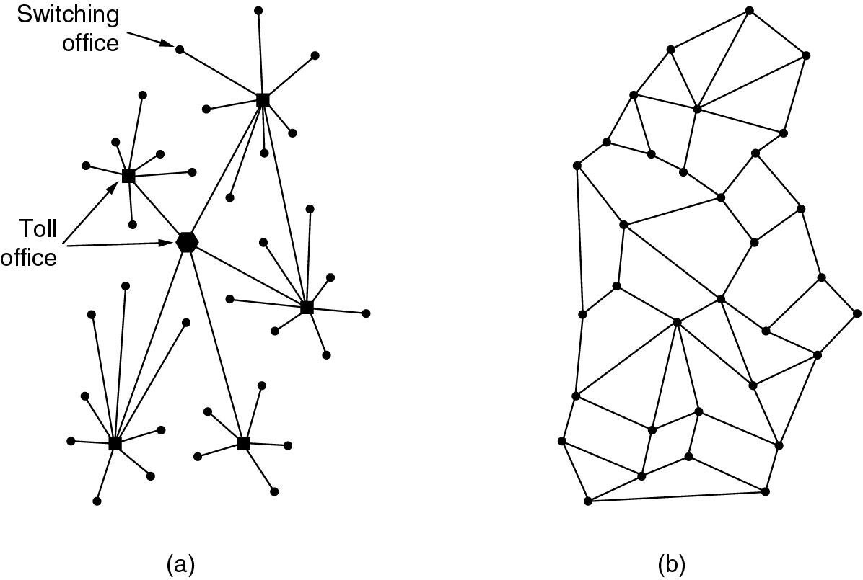
The ARPANET
The vulnerability of the telephone system was a concern.
(a) Telephone system structure; (b) Distributed switching system structure

Slide 24
The ARPANET Design
Connection-less packet transmission
Packets are encapsulated in frames
Error control uses check bits
Destinations identified by unique addresses
Routing tables at the packet switches
Messages are segmented into packets
End-to-end congestion control
Flow control prevents buffer overflow

Slide 25
ARPANET Applications
ARPANET (NSF-NET) introduced new applications
Email, remote login, file transfer, …
AMES
McCLELLAN
UTAH
BOULDER
GWC
CASE
RADC
ILL
LINC
CARN
AMES
USC
MIT
UCSB
MITRE
STAN
SCD
ETAC
UCLA
RAND
TINKER
BBN
HARV
NBS

Slide 26
Ethernet Local Area Network
In 1980s, affordable workstations available
Need for low-cost, low error rate, high-speed network, possible using coaxial cable
Broadcasting, medium access control
Network interface card with a unique address
Ethernet is the standard for high-speed wired access to computer networks

Slide 27
Summary of the Lesson
Services and Applications drive network architecture design

Slide 28
Unit 01.01.03 CS 5220: COMPUTER COMMUNICATIONS
Examples of Protocols and Services
XIAOBO ZHOU, Ph.D.
Professor, Department of Computer Science

Slide 29
Services & Applications
Service: information transfer capability
Internet transfer of individual block of information
Internet reliable transfer of a stream of bytes
Real-time transfer of a voice signal
Applications build on communication services
E-mail & web build on reliable stream service
New applications build on multiple networks
SMS builds on Internet reliable stream service and cellular telephone text messaging

Slide 30
Layers, Services & Protocols
The overall communications process between machines connected across one or more networks is very complex
Layering partitions related communications functions into groups that are manageable
Each layer provides a service to the layer above
Each layer operates according to a protocol

Slide 31

DNS
A. 64.15.247.200
Q. www.nytimes.com?
User clicks on http://www.nytimes.com/
URL contains Internet name of machine (www.nytimes.com), but not Internet address
Internet needs Internet address to send information to a machine
Browser software uses Domain Name System (DNS) protocol to send query for Internet address
DNS system responds with Internet address

Slide 32
2. TCP
ACK
ACK, TCP Connection Request
From: 64.15.247.200 Port 80 To:128.100.11.13 Port 1127
TCP Connection Request
From: 128.100.11.13 Port 1127
To: 64.15.247.200 Port 80
Browser software uses HTTP to send request for document
HTTP server waits for requests by listening to a well-known port number (80 for HTTP)
HTTP client sends request messages through an “ephemeral port number,” e.g. 1127
HTTP needs a Transmission Control Protocol (TCP) connection between the HTTP client and HTTP server to transfer messages reliably

Slide 33
3. HTTP
Content
200 OK
GET / HTTP/1.1
HTTP client sends its request message: “GET comm.html …”
HTTP server sends a status response: “200 OK”
HTTP server sends requested file
Browser displays document
Clicking a link sets off a chain of events across the Internet!

Slide 34
Protocols
A protocol is a set of precise & unambiguous rules that governs
how two or more communicating entities in a layer are to interact
Messages that can be sent and received
Actions that are to be taken when a certain event occurs
The purpose of a protocol is to provide a service to the layer above

Slide 35
Example: HTTP
HTTP is an application layer protocol
Retrieves documents on behalf of a browser application program
HTTP specifies fields in request messages and response messages
Request types; Response codes
Content type, options, cookies, …
HTTP specifies actions to be taken upon receipt of certain messages

Slide 36
HTTP uses service of TCP
HTTP
client
HTTP
server
GET
Port 1127
Port 80
TCP
TCP

Slide 37
HTTP uses service of TCP - CONT
HTTP
client
HTTP
server
Port 1127
Port 80
TCP
80, 1127
TCP
GET
TCP

Slide 38
HTTP uses service of TCP- CONT
HTTP
client
HTTP
server
Port 1127
Port 80
GET
TCP
TCP

Slide 39
HTTP uses service of TCP- CONT
HTTP
client
HTTP
GET
RESPONSE
Port 1127
Port 80
TCP
TCP

Slide 40
HTTP uses service of TCP- CONT
HTTP
client
HTTP
Port 1127
Port 80
1127, 80
RESPONSE
TCP
TCP

Slide 41
HTTP uses service of TCP- CONT
HTTP
client
HTTP
GET
Port 1127
Port 80
TCP
RESPONSE

Slide 42
Example: DNS Protocol
DNS protocol is an application layer protocol
DNS is a distributed database that resides in multiple machines in the Internet
DNS protocol allows queries of different types
DNS usually involves short messages and so uses service provided by UDP
Well-known port 53

Slide 43
Local
Name
Server
Authoritative
Name
Server
1
5
4
2
3
6
Root
Name
Server
Local Name Server: resolve frequently-used names
E.g., University department, ISP
Root Zone Name Servers
Resolves query or refers query to Authoritative Name Server
Authoritative Name Server: last resort, 13 autoorities
Every machine must register its address with at least two servers

Slide 44
Summary
Services: a protocol provides a communications service to the layer above
DNS servers are one primary target of cyber attacks

